Slide 1
Deep Learning (COSE474) 2024 Fall
Final Project Topics
Hyunwoo J. Kim
(hyunwoojkim@korea.ac.kr)

Slide 2
Agenda
Rules/Evaluation
Possible project topics?
Notes:
Nest
https://www.droid-life.com/2018/10/11/google-assistant-upgrades-smart-display/

Slide 3
Rule and Evaluation
Rule? Resources?
Computing resource: Colab/AWS/local GPU Servers (default: colab pro)
Evaluation
Absolute Grading
We do NOT expect the state-of-the-art performance
We expect you to learn how to design an AI project and develop an AI algorithm.
It includes motivations, related works, methods (formulation, architecture), experiments (data preparation, hyperparameter tuning, quantitative/qualitative experimental results), discussion & future direction.
Notes:
Nest
https://www.droid-life.com/2018/10/11/google-assistant-upgrades-smart-display/

Slide 4
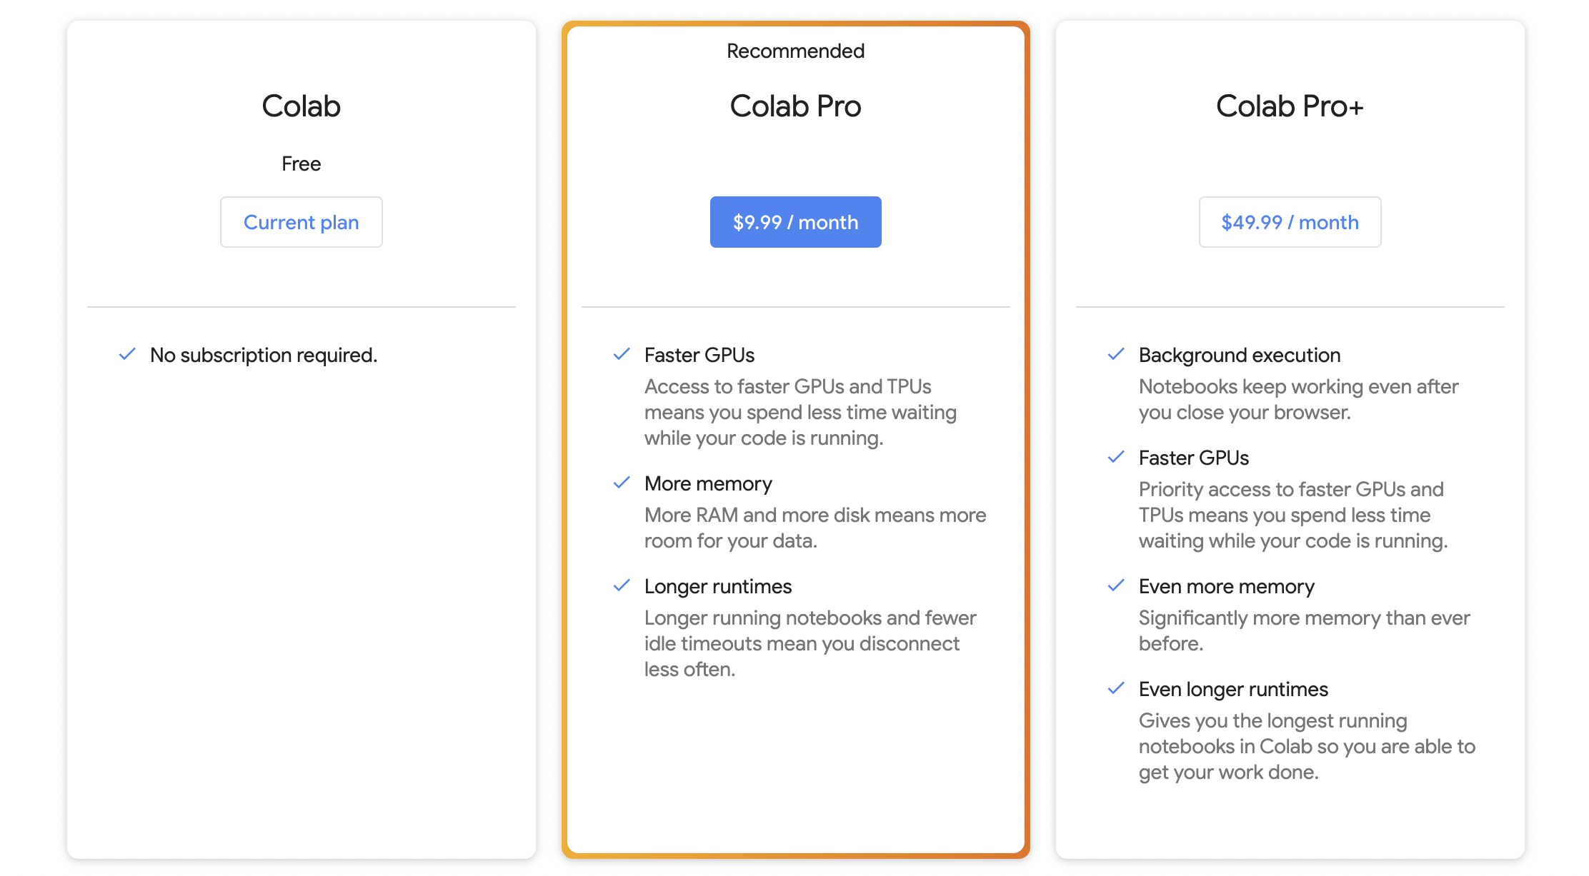
Computing resources
Colab/Colab Pro/Colab Pro+/your own GPUs/AWS
Describe your computing resources and reformulate your problem managable
Colab Pro $10/month
Colab Pro+ $50/month

Slide 5
Evaluation:report (tentative)
Evaluation (2024) – KOR or ENG
basic points (overall) (2): length (0.5), format (0.5), clarity of writing (1)
Introduction (5): motivation (2), problem definition (2), concise description of contribution (1)
Methods (5): significance/novelty (2), figure (1), reproducibility (2)-algorithm
Experiments (7): dataset (1), computer resource (CPU,GPU, OS, pytorch etc.) & experimental design (1), quantitative results (1), qualitative results (1), Figures (plots)/Tables and their analysis (2), discussion why the proposed method is successful or unsuccessful (1)
Future direction (1).
Github history (2)
Overleaf history (2)
(Bonus+1) pre-trained foundation models beyond ImageNet-pretrained CNNs (distillation, adaption, pseudo-labeling, baseline etc.), CLIP, BERT, RoBERTa
Notes:
Nest
https://www.droid-life.com/2018/10/11/google-assistant-upgrades-smart-display/

Slide 6
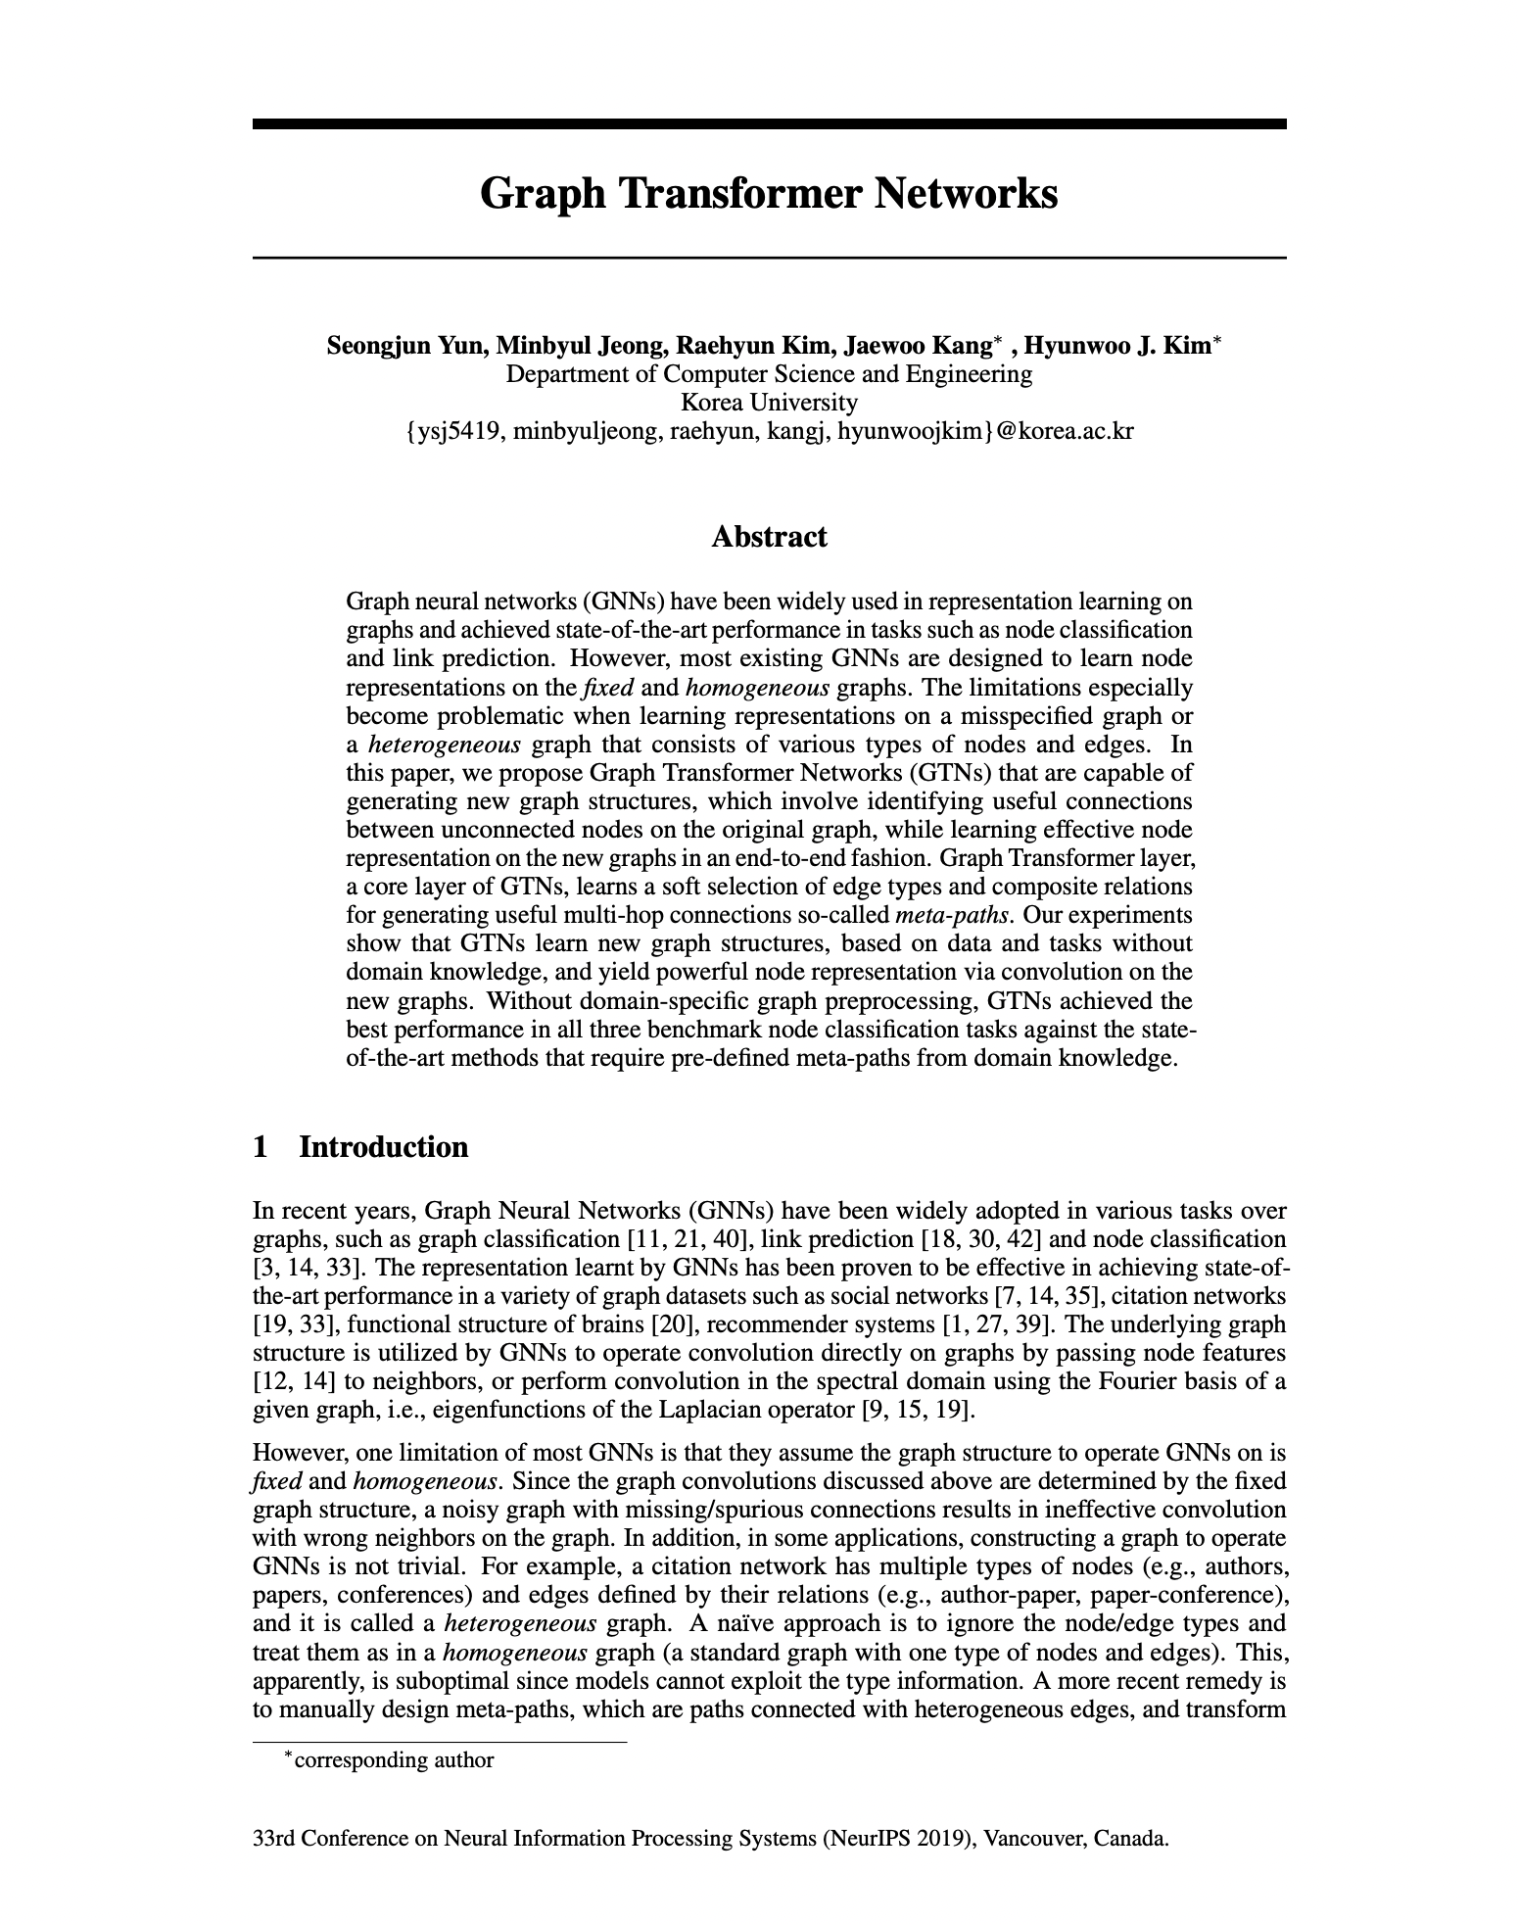
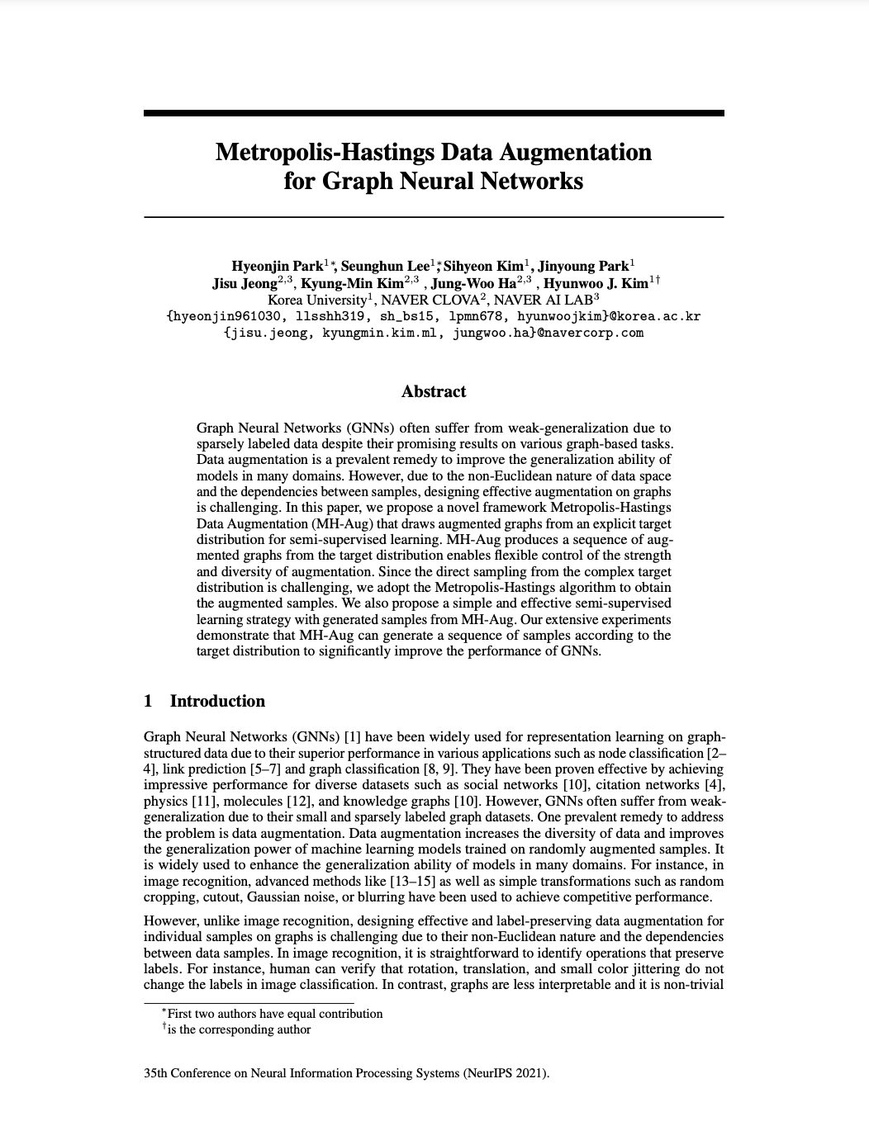
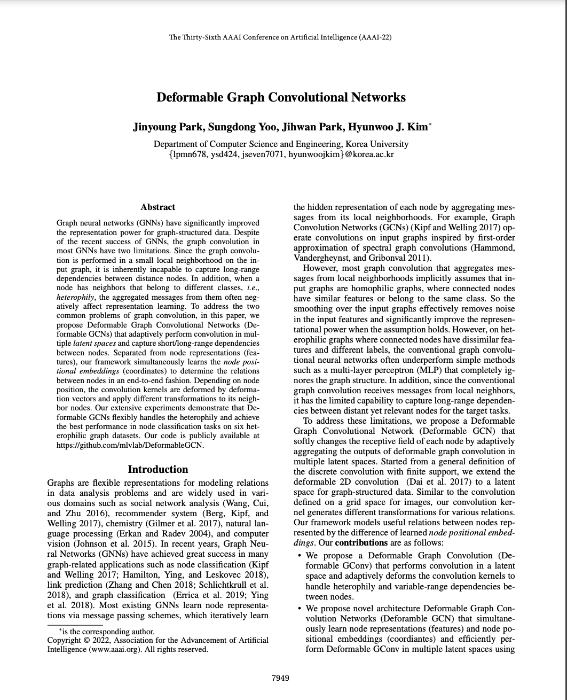
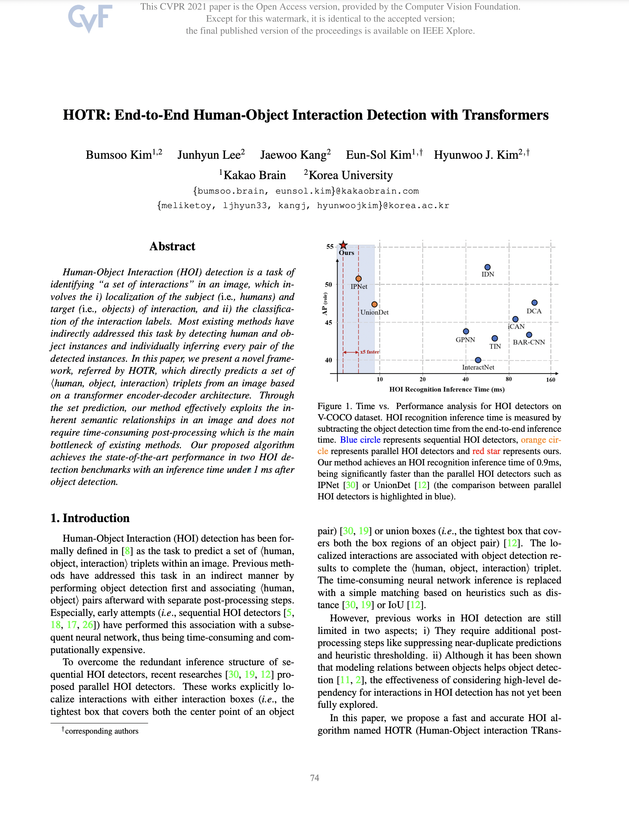
Good Examples for your final report
Please check papers from top-tier AI conferences
NeurIPS 19
NeurIPS 21
AAAI 22
CVPR 21 (Oral)

Slide 7
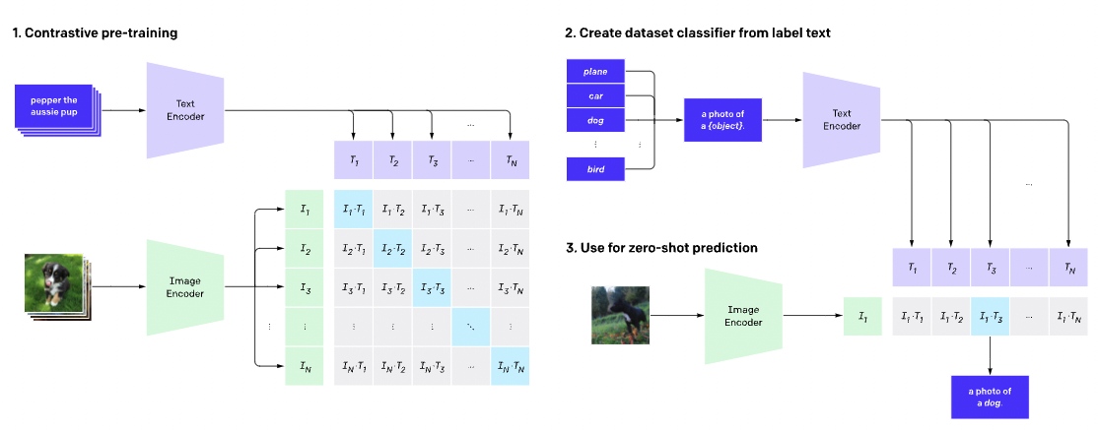
Foundation Models CLIP: Connecting Text and Images

Slide 8
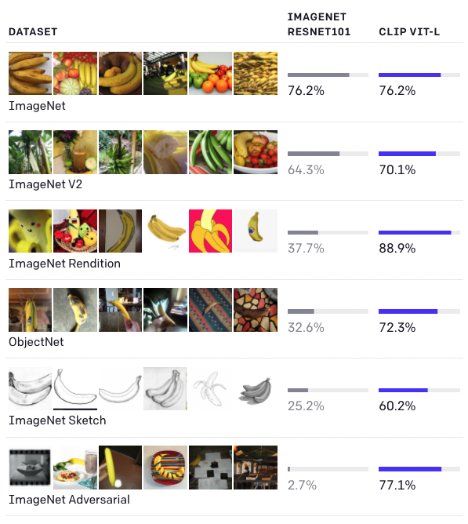
CLIP: Connecting Text and Images
CLIP which efficiently learns visual concepts from natural language supervision.
CLIP can be applied to any visual classification benchmark by simply providing the names of the visual categories to be recognized, similar to the “zero-shot” capabilities of GPT-2 and GPT-3.

Slide 9
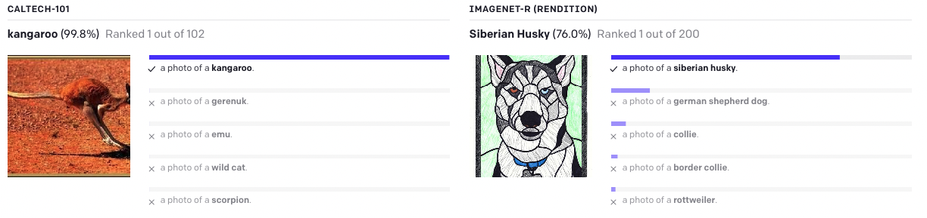
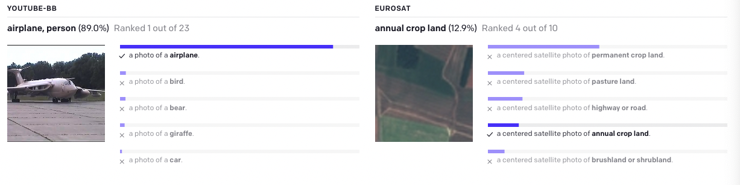

Slide 10
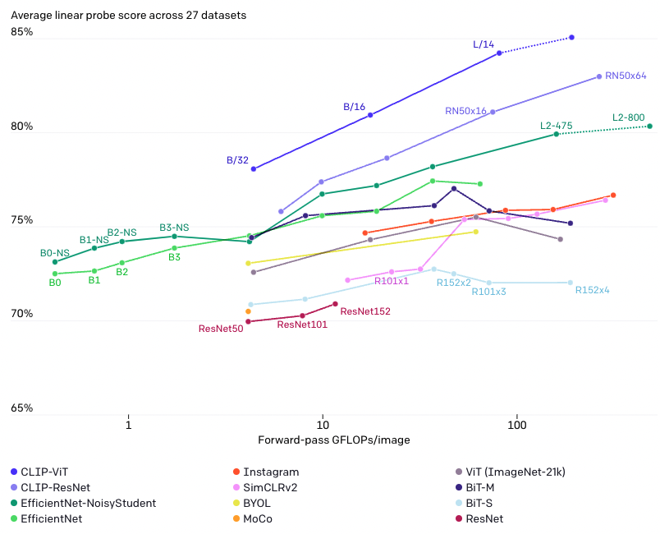

Slide 11
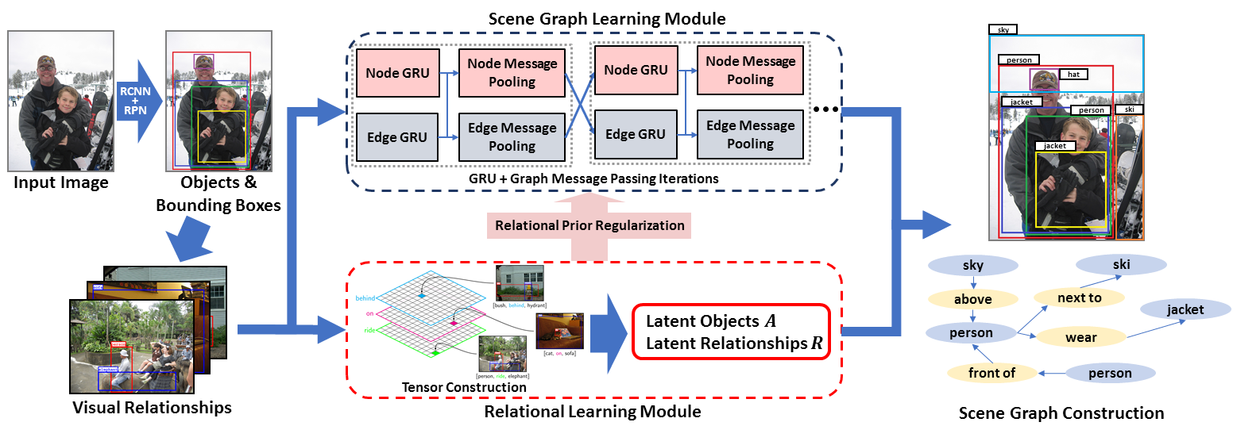
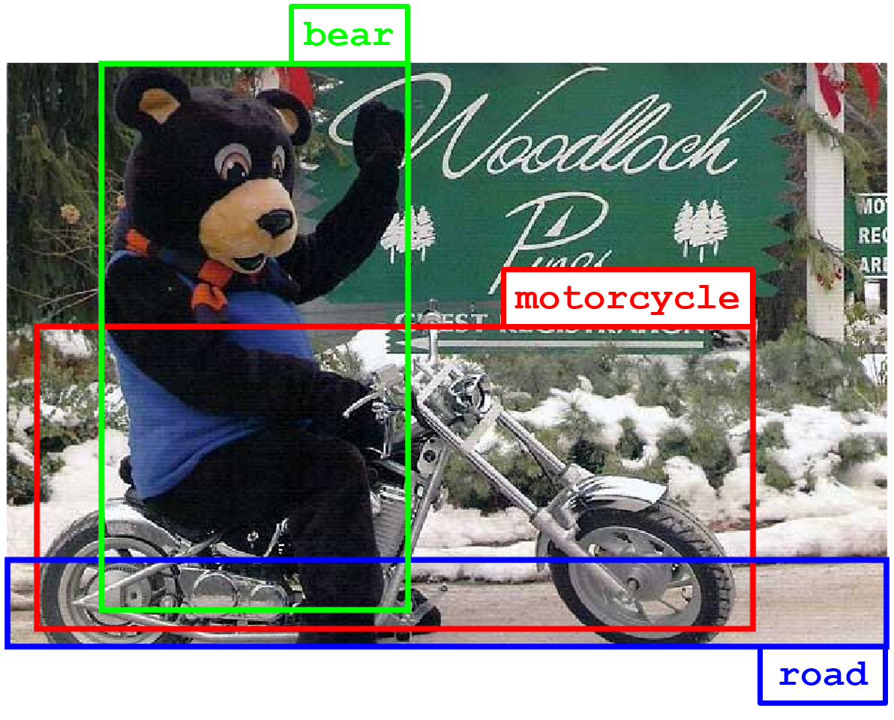
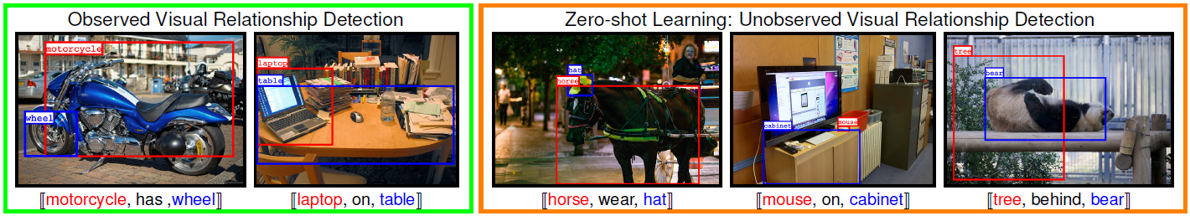
Scene understanding Scene graph generation
[CVPR ’18] Tensorize, Factorize and Regularize: Robust Visual Relationship Learning
[CVPR ’18] Tensorize, Factorize and Regularize: Robust Visual Relationship Learning

Slide 12
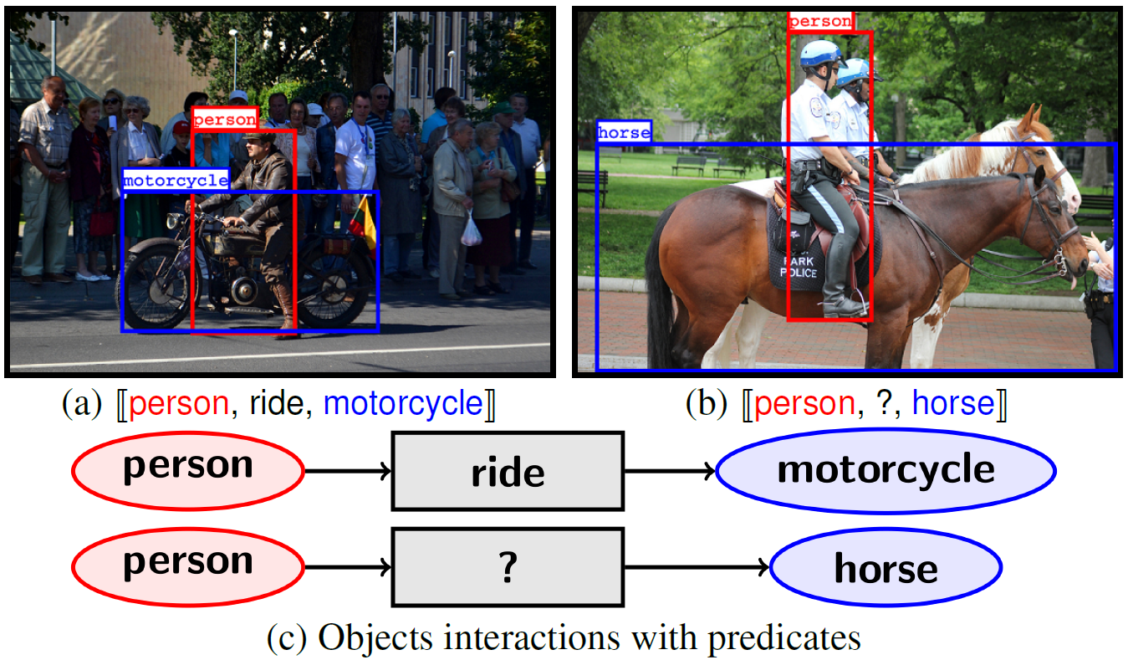
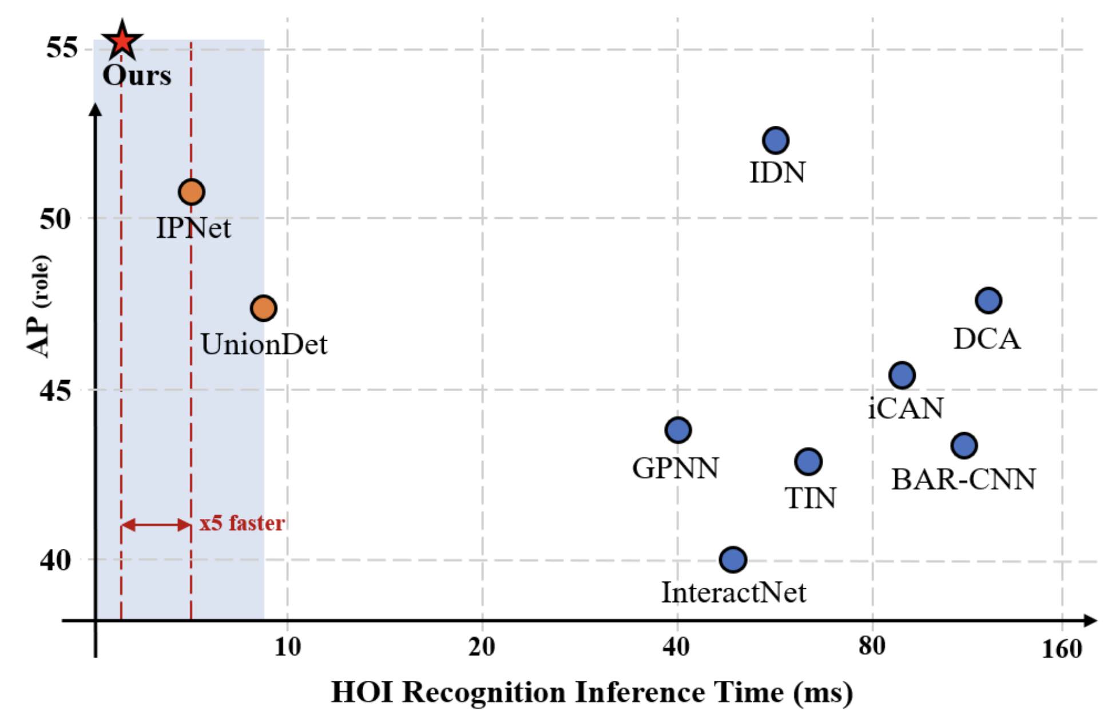
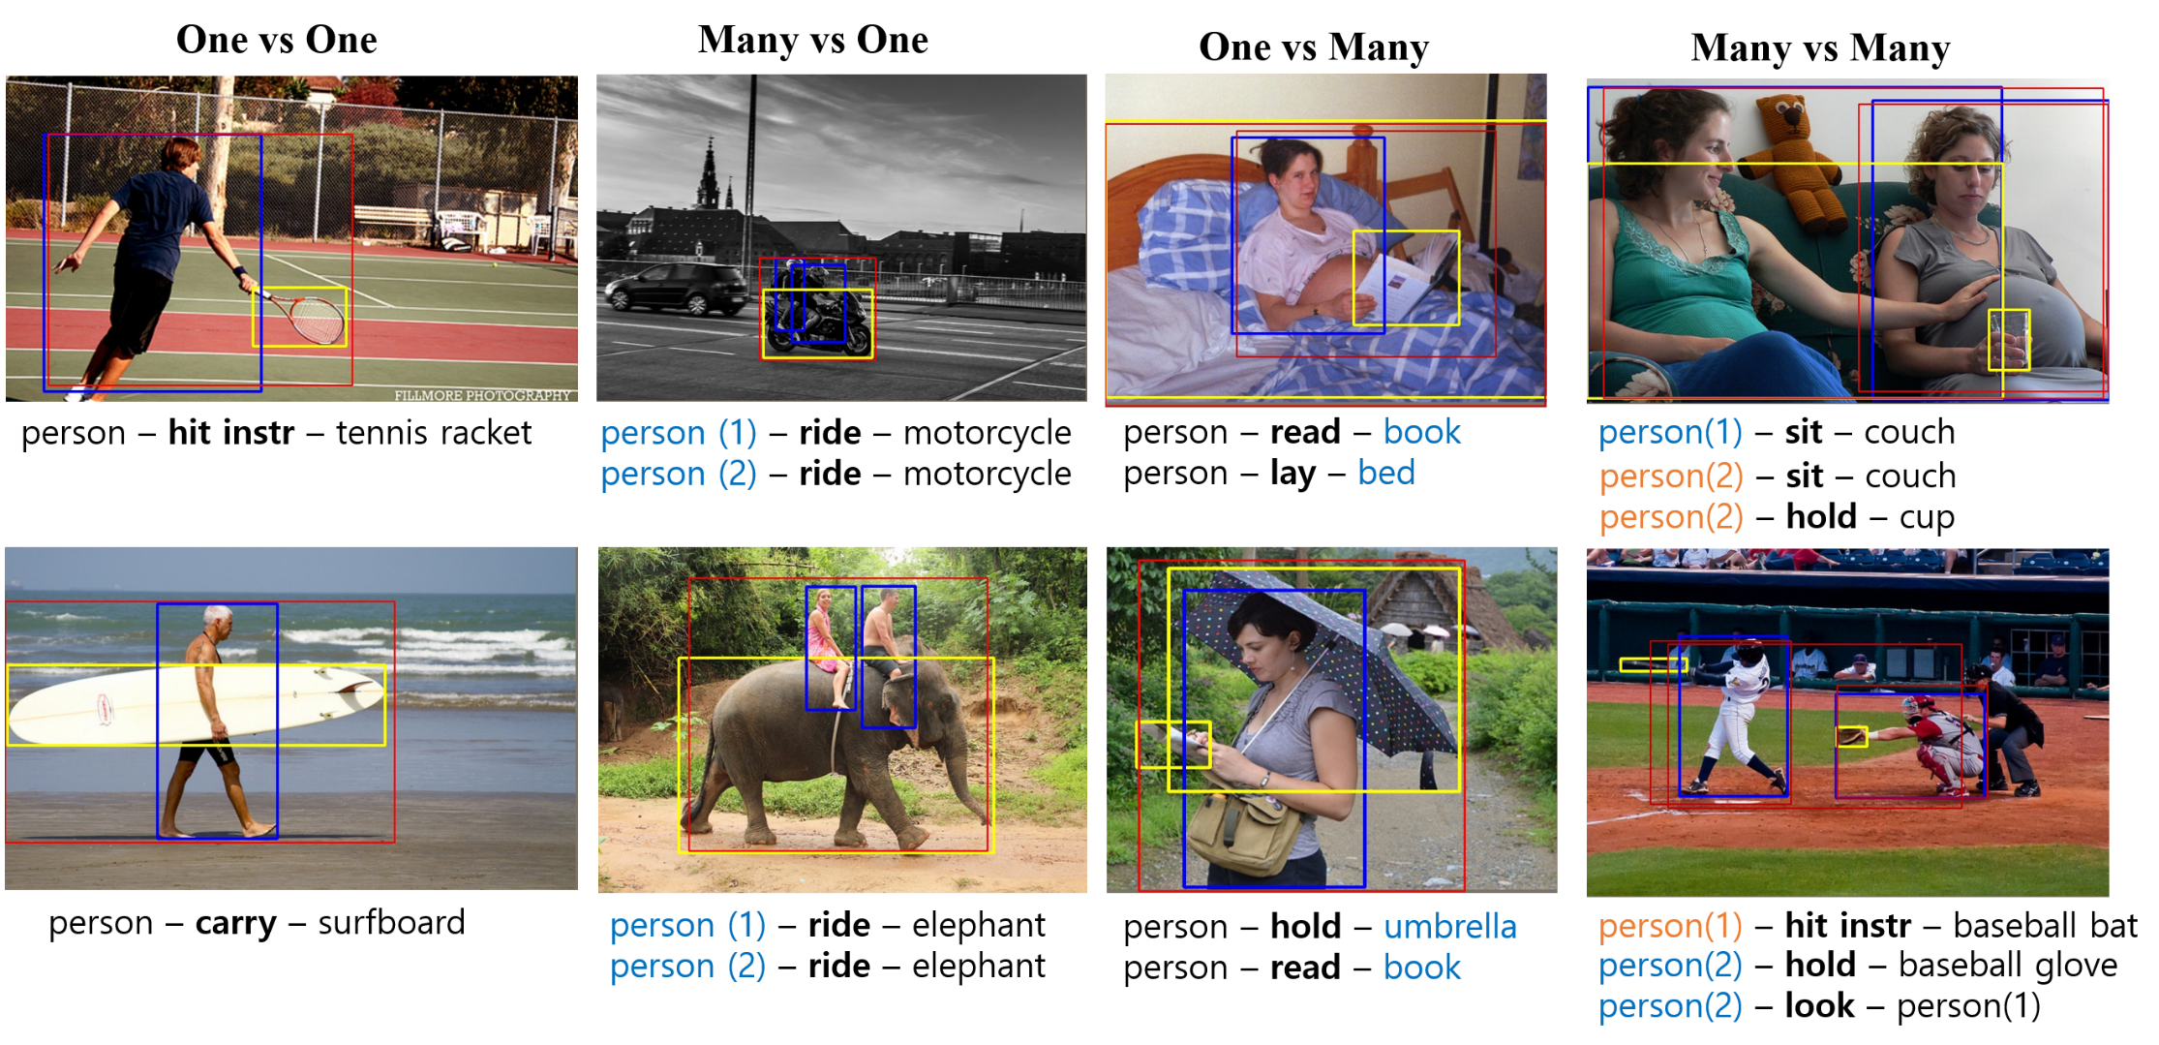
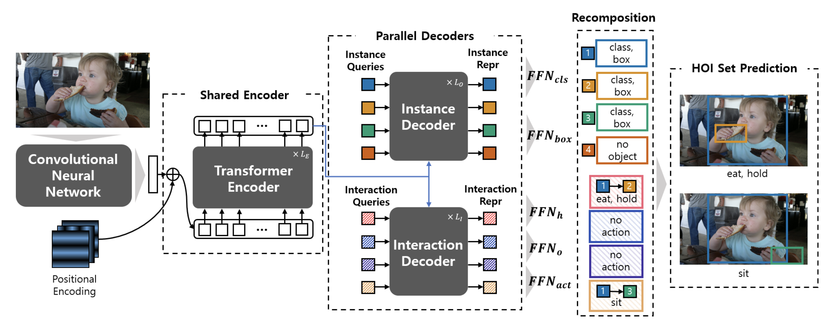
Scene understanding and object detection
[CVPR18] Tensorize
[ECCV20] UnionDet
[CVPR ’21 (ORAL)] HOTR
[CVPR ’21 (ORAL)] HOTR: End-to-End Human-Object Interaction Detection with Transformers

Slide 13
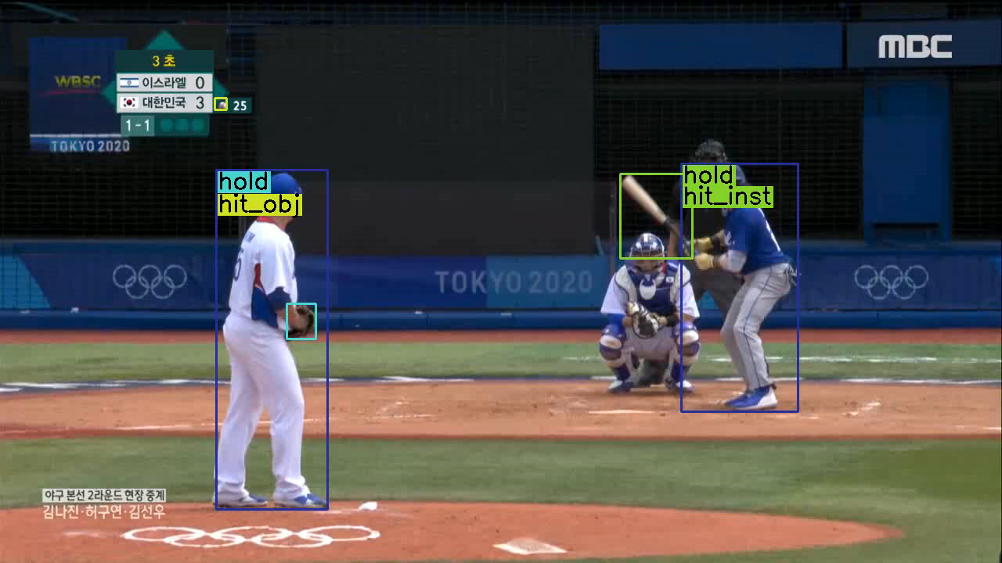

Slide 14

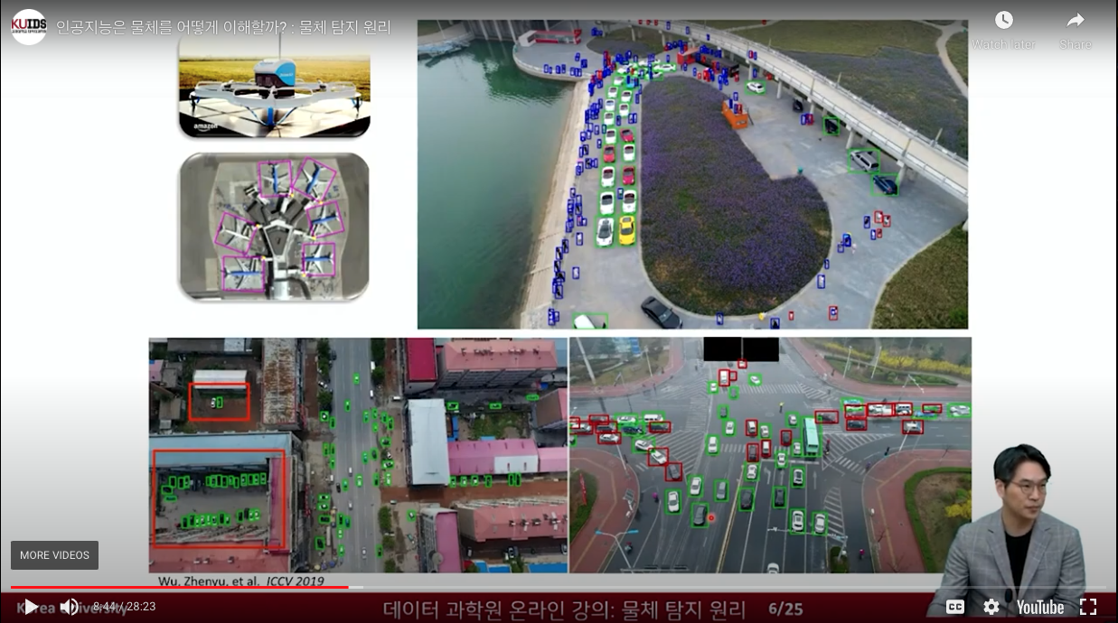


물체 탐지 강의 (데이터 과학원)
물체 탐지 원리
[LInk]
2. 물체 탐지 기법
[Link]
3. 물체간 관계 추론
[Link]

Slide 15
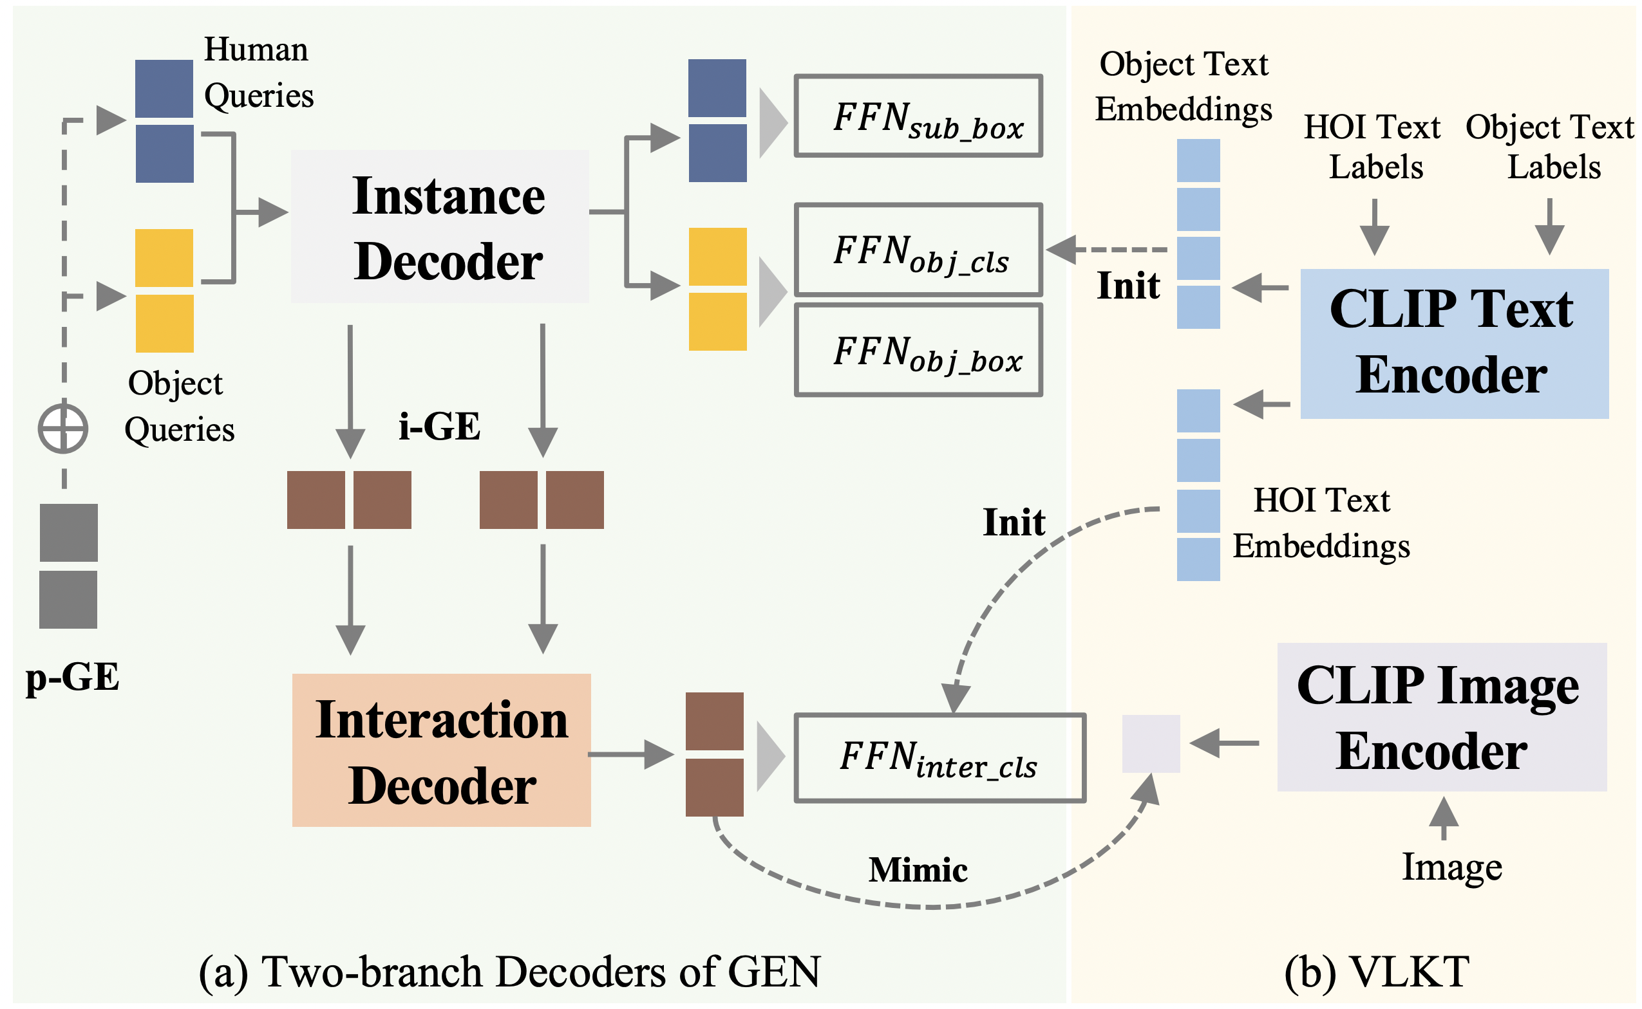
초거대 AI + 장면이해? Latent space alignment
[CVPR22] GEN-VLKT: Simplify Association and Enhance Interaction Understanding for HOI Detection

Slide 16
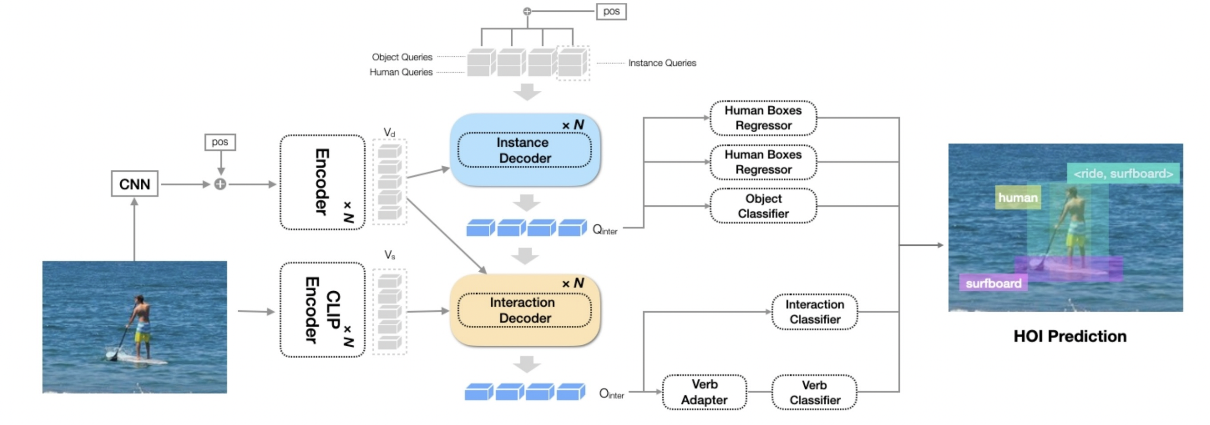
초거대 AI + 장면이해?
HOICLIP: Efficient Knowledge Transfer for HOI Detection with Vision-Language Models

Slide 17
Examples: MLV top-tier conference papers (2023)
[EMNLP23] Large Language Models are Temporal and Causal Reasoners for Video Question Answering
[NeurIPS23] NuTrea: Neural Tree Search for Context-guided Multi-hop KGQA
[NeurIPS23] Advancing Bayesian Optimization via Learning Smooth Latent Spaces
[NeurIPS23] Unconstrained Pose Prior-Free Neural Radiance Field
[ICCV23] Open-Vocabulary Video Question Answering: A New Benchmark for Evaluating the Generalizability of Video Question Answering Models
[ICCV23] Distribution-Aware Prompt Tuning for Vision-Language Models
[ICCV23] Semantic-Aware Template Learning via Part Deformation Consistency
[ICCV23] Read-only Prompt Optimization for Vision-Language Few-shot Learning
[ICML23] Robust Camera Pose Refinement for Multi-Resolution Hash Encoding
[CVPR23] MELTR: Meta Loss Transformer for Learning to Fine-tune Video Foundation Models
[CVPR23] Self-positioning Point-based Transformer for Point Cloud Understanding
[AAAI23] Relation-aware Language-Graph Transformer for Question Answering

Slide 18
Examples: MLV top-tier conference papers (2024)
[NeurIPS] LLaMo: Large Language Model-based Molecular Graph Assistant
[NeurIPS] Alleviating Attention Bias for Visual-Informed Text Generation
[NeurIPS] Constant Acceleration Flow
[NeurIPS] Inversion-based Latent Bayesian Optimization
[EMNLP] Generative Subgraph Retrieval for Knowledge Graph–Grounded Dialog Generation
[ECCV] Diffusion Prior-Based Amortized Variational Inference for Noisy Inverse Problems
[ECCV] Understanding Multi-compositional learning in Vision and Language models via Category Theory
[ICML] Stochastic Conditional Diffusion Models for Robust Semantic Image Synthesis
[CVPR] vid-TLDR: Training Free Token merging for Light-weight Video Transformer
[CVPR] Multi-criteria Token Fusion with One-step-ahead Attention for Efficient Vision
[CVPR] Groupwise Query Specialization and Quality-Aware Multi-Assignment for Transformer-based Visual Relationship Detection
[CVPR] Prompt Learning via Meta-Regularization
[CVPR] Retrieval-Augmented Open-Vocabulary Object Detection
[ICLR] Domain-agnostic Latent Diffusion Models for Synthesizing High-Quality Implicit Neural Representations

Slide 19
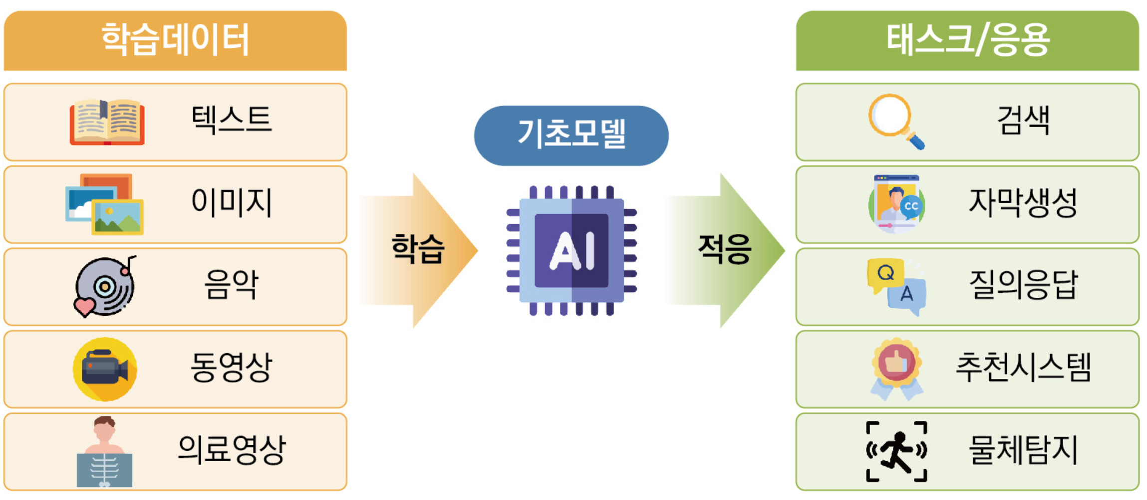
Foundation Models (기초모델)

Slide 20
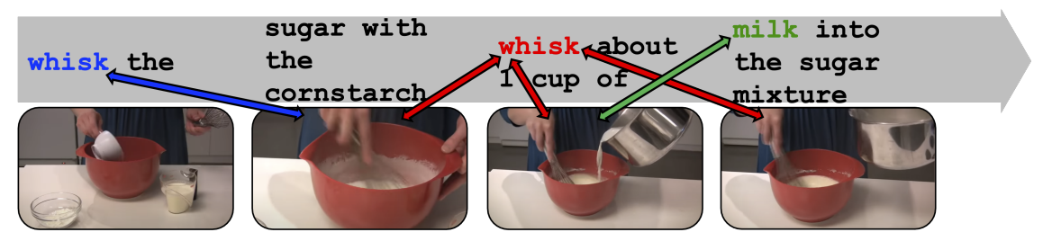
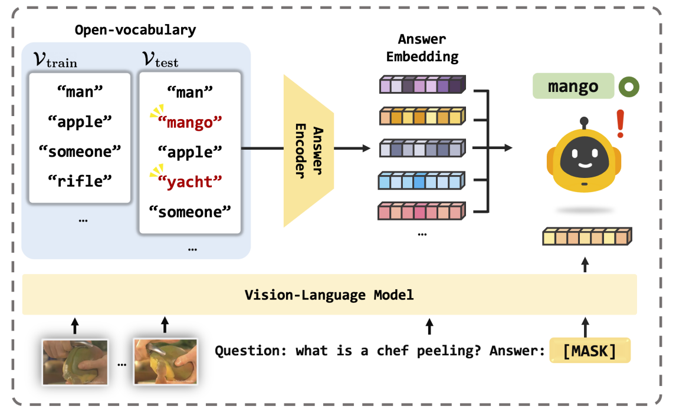
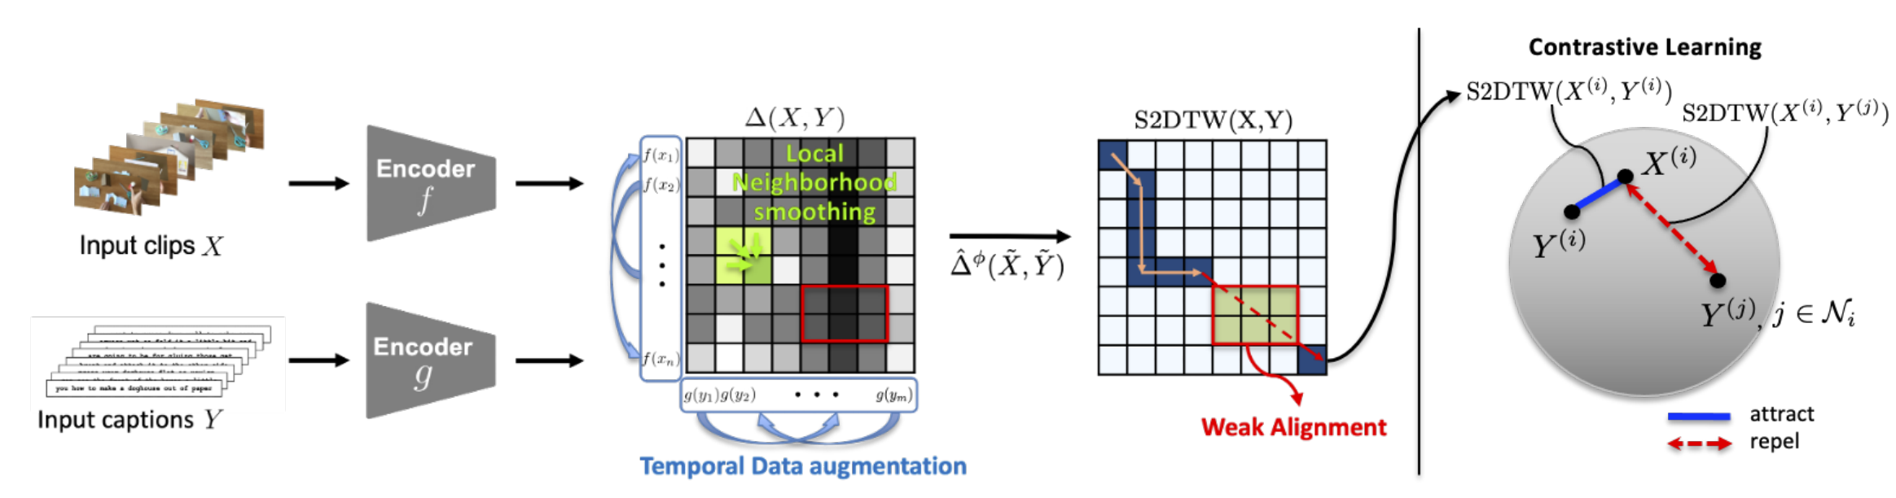
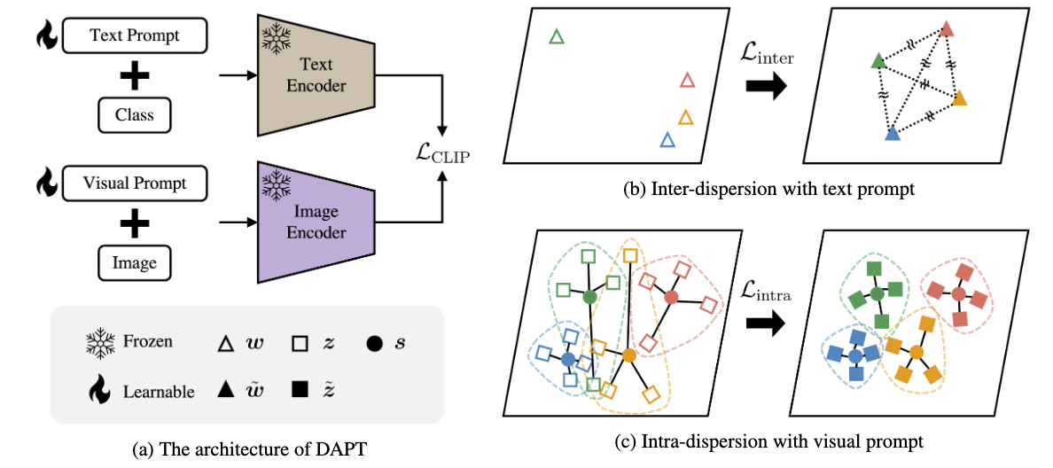
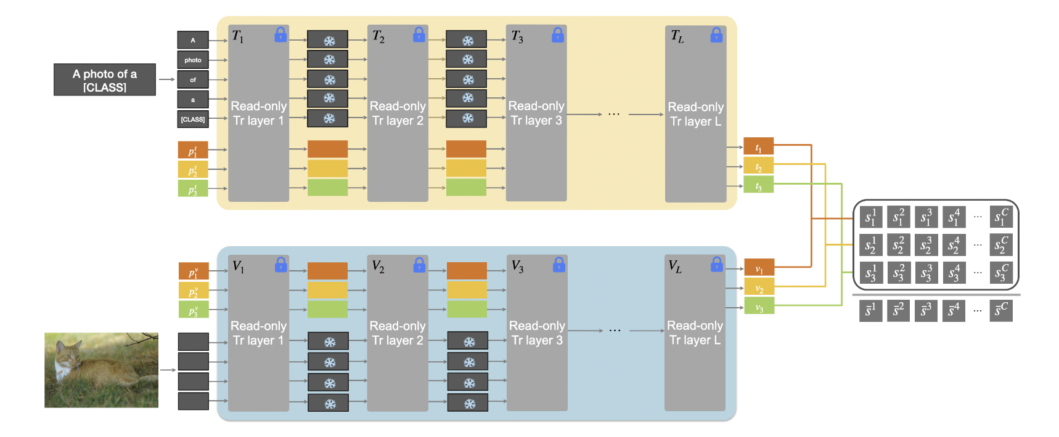
초거대 AI: Foundation Models
[CVPR22] VT-TWIN. (1억개 유투브 클립학습. 비디오 기초모델)
[ICCV23] 거대 동영상 기초모델 기반 오픈-사전 비디오 QA 시스템
[ICCV23] DAPT. CLIP 기반 few-shot learning
[ICCV23] RPT. 기초모델 위한 읽기 중심 프롬프트 튜닝

Slide 21
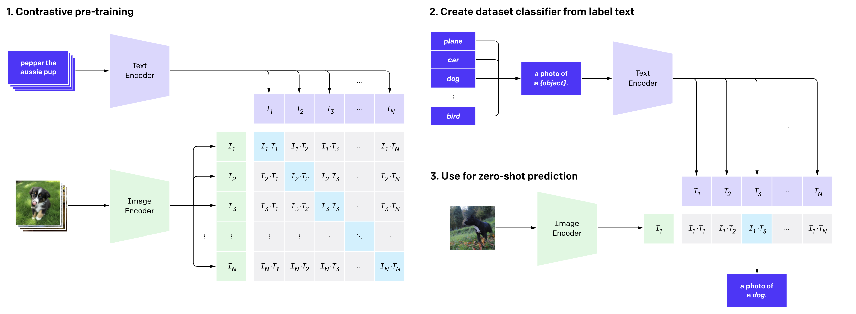
Contrastive Learning (CLIP)
A photo of _______
프롬프트엔지니어링
제로샷 분류기
Self-Supervised Learning (자기지도학습)
Radford, Alec, et al. "Learning transferable visual models from natural language supervision." ICML 2021.

Slide 22
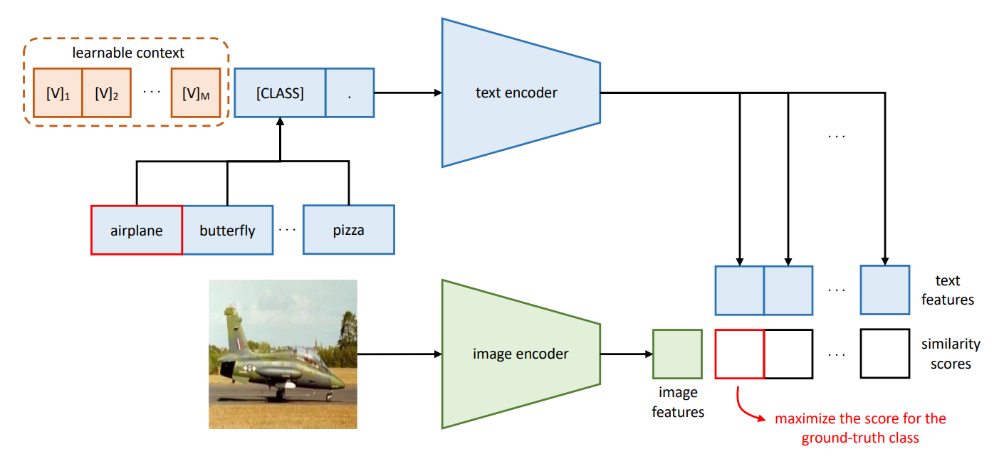
Prompt Learning (CoOp)
~ A photo of _______
Prompt tuning
Learning to prompt for vision-language models (IJCV 2022)

Slide 23
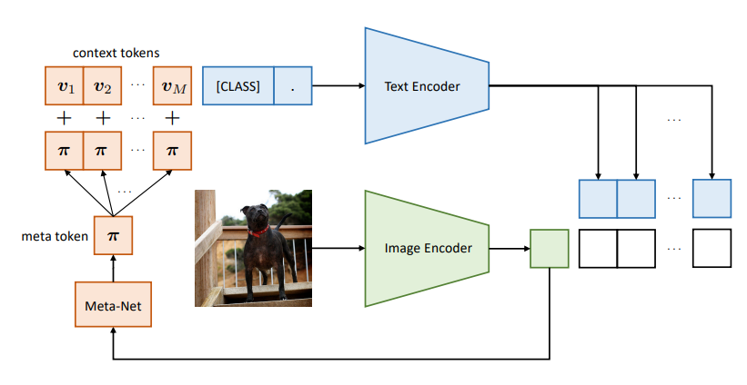
CoCoOp
Image-aware prompt modulation
Conditional prompt learning for vision-language models (CVPR 2022)

Slide 24
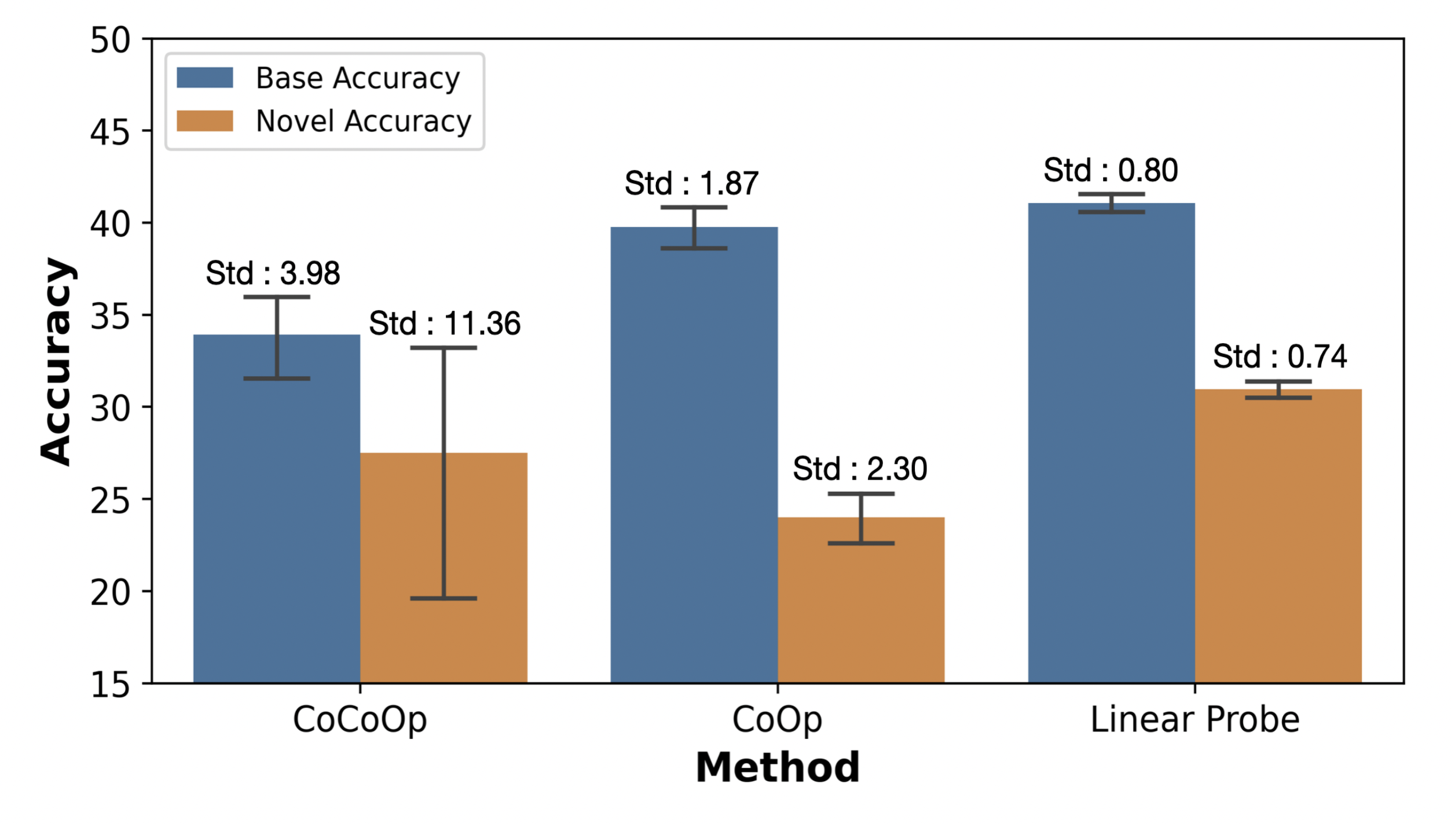
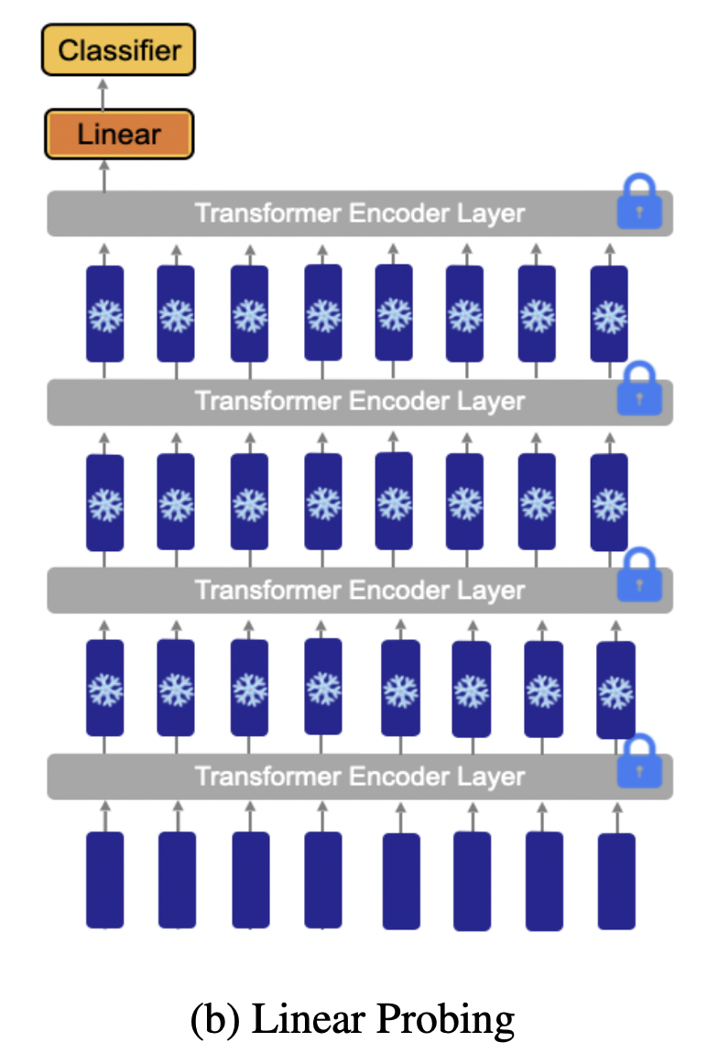
Our Observation
Linear Probe achieved better performance with small VAR (std).
[ICCV23] Read-only Prompt Optimization

Slide 25
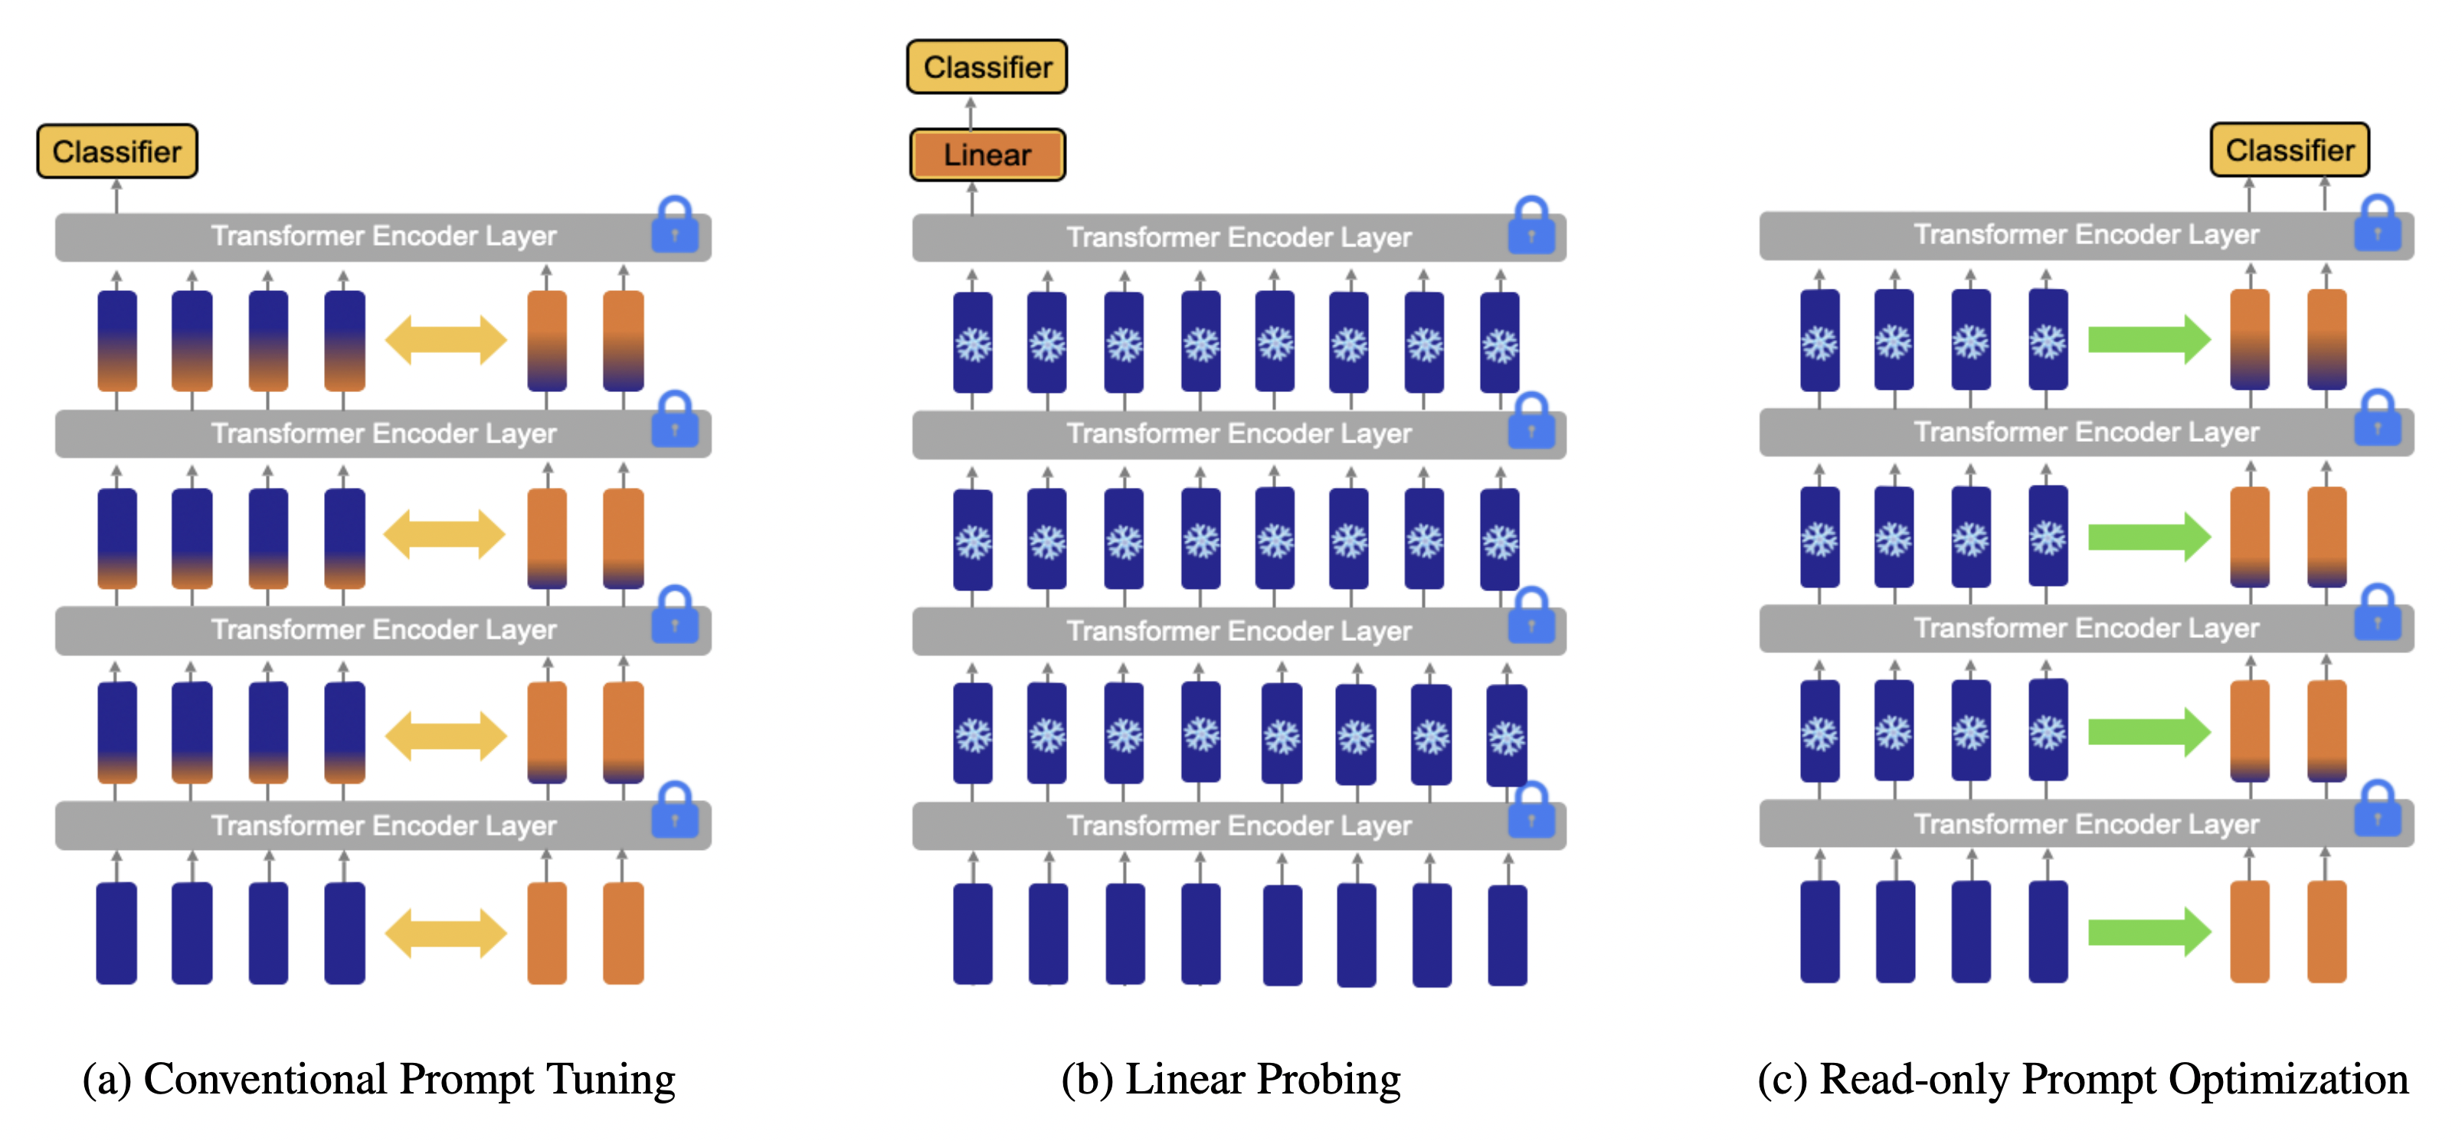
Read-only Prompt Optimization
[ICCV23] Read-only Prompt Optimization

Slide 26
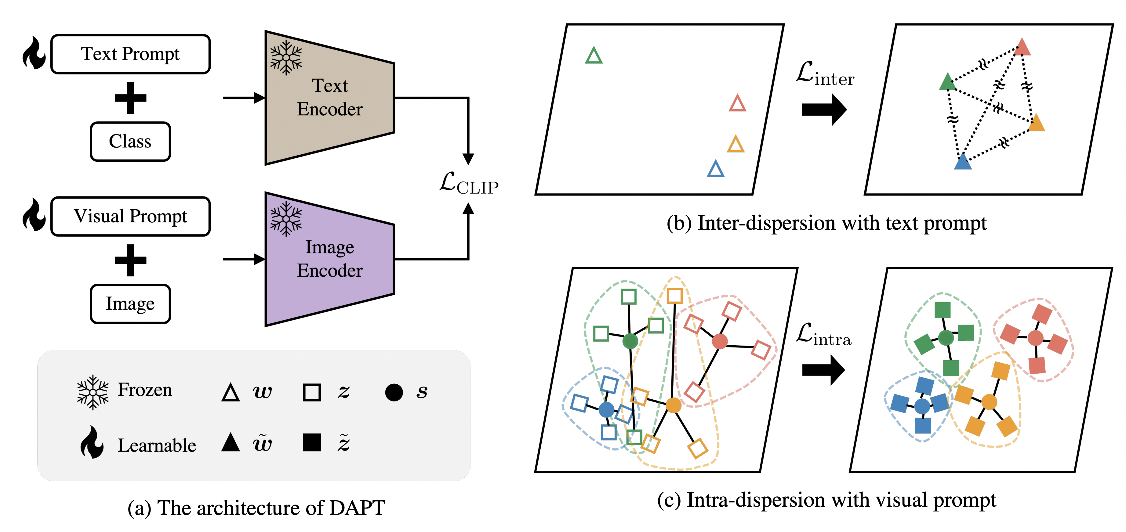
Distribution-Aware Prompt Tuning
Car
Car
Ship
Ship
Inter VAR
Cat
Cat
Dog
Dog
Intra VAR
[ICCV23] Distribution-Aware Prompt Tuning for Vision-Language Models

Slide 27
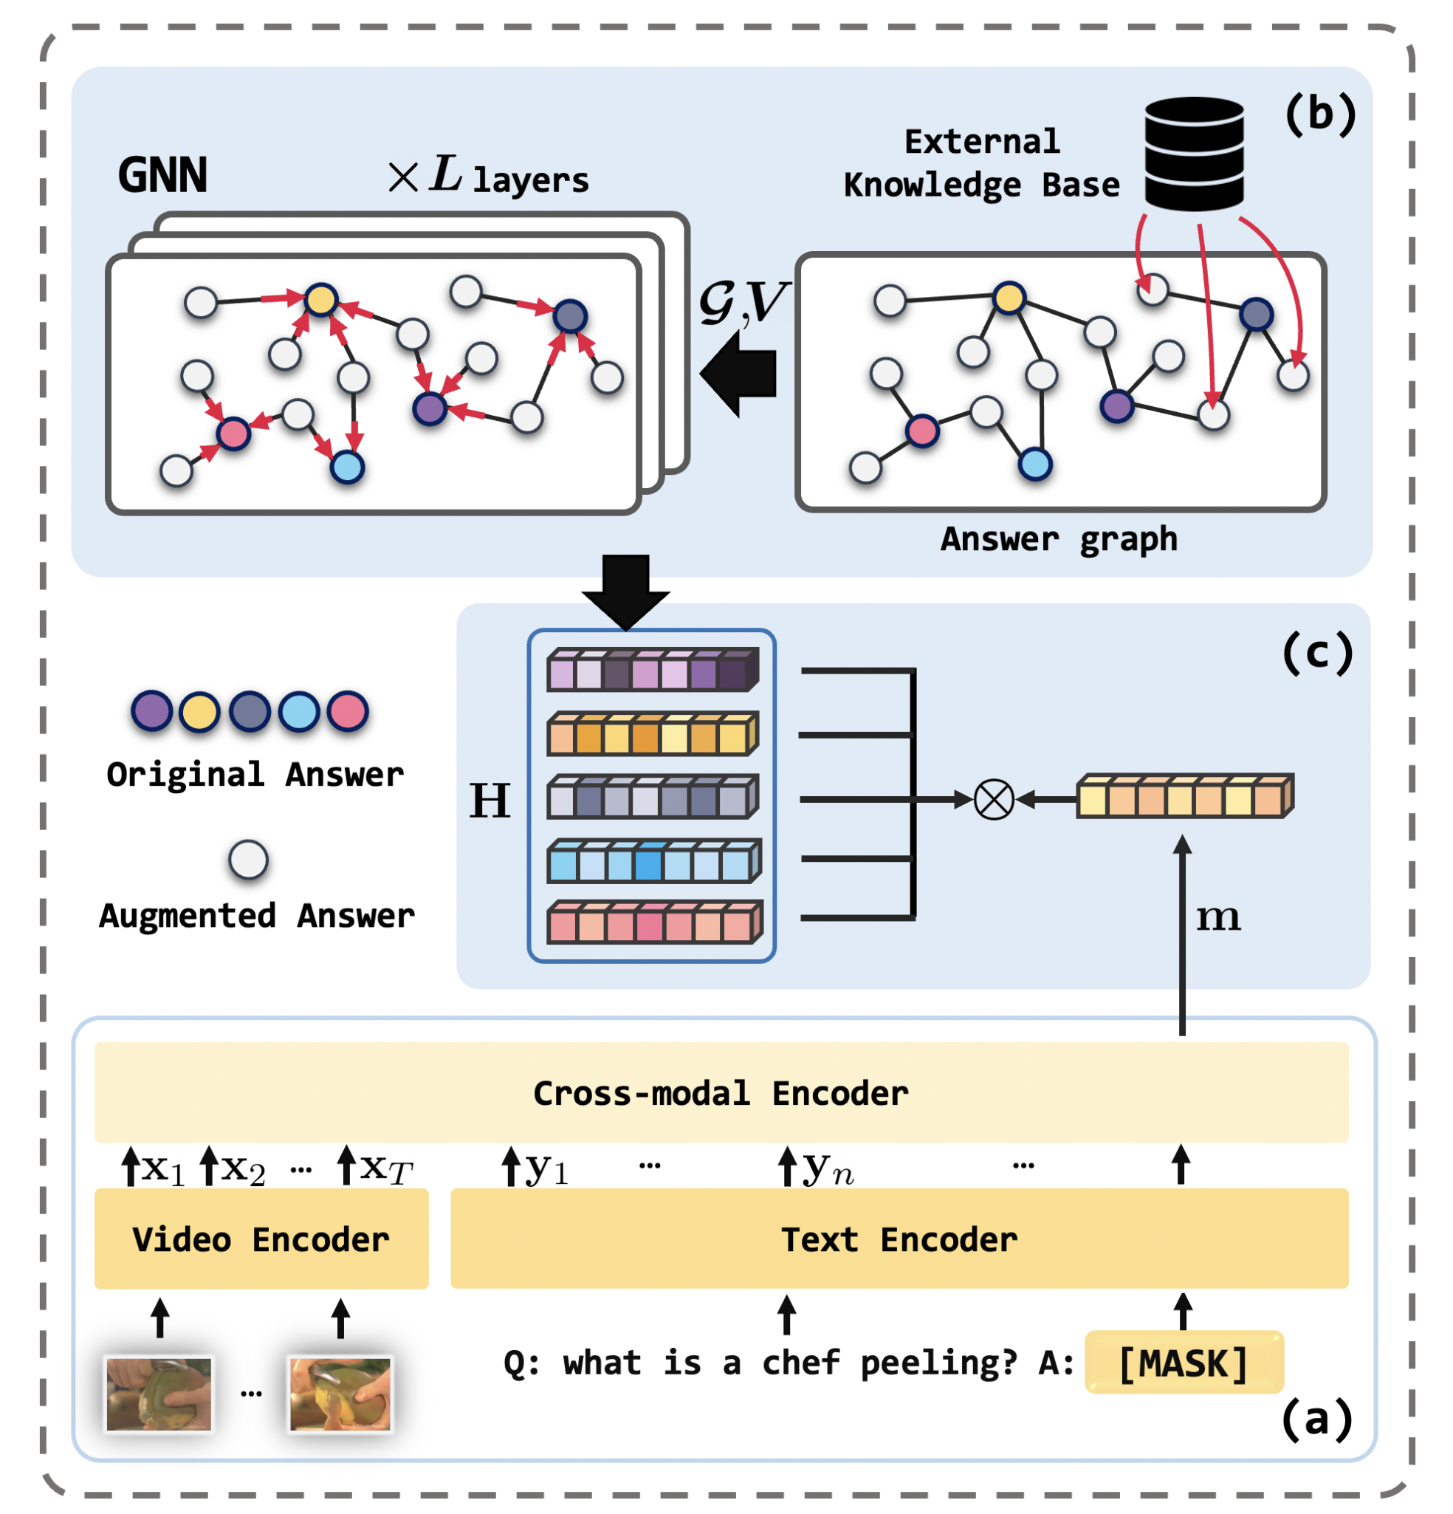
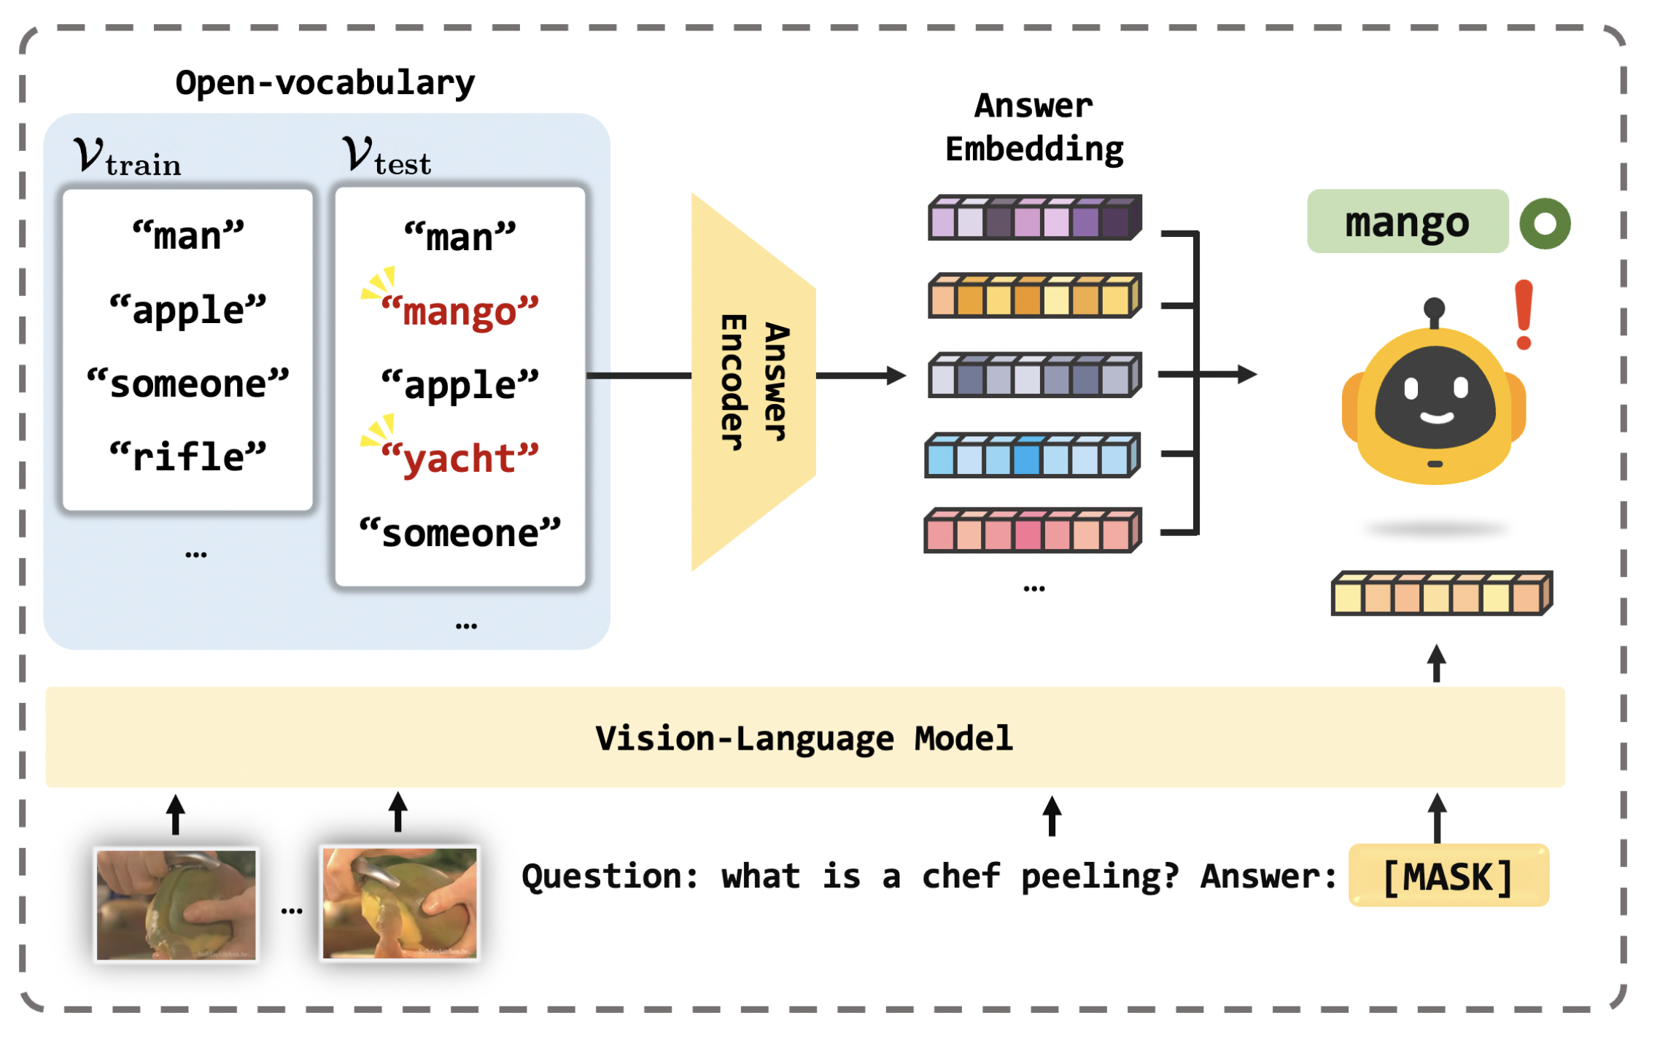
Video Question Answering
New Benchmark
Label smoothing by GNNs
Vision-Language Model
Cross-Modal Encoder thanks to Transformers
[ICCV23] Open-Vocabulary Video Question Answering

Slide 28
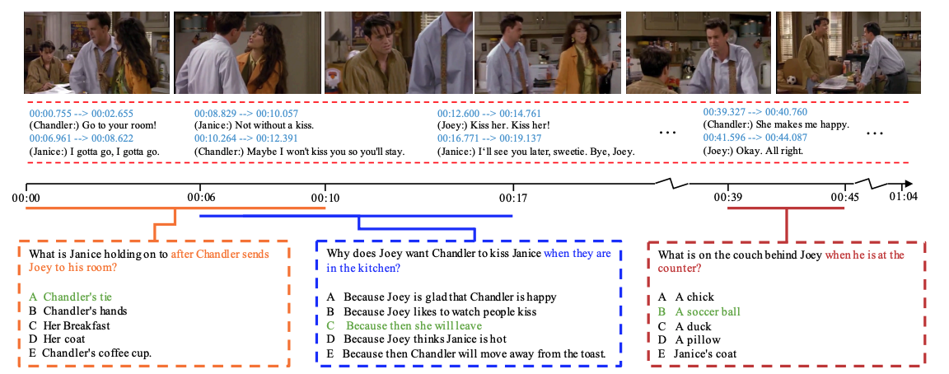
Video QA
Downstream tasks
- Video question answering
Dataset:
TGIF
MSVD
Evaluation metric:
Accuracy
Causal
Temporal
Descriptive
Jie Lei et al. TVQA: Localized, Compositional Video Question Answering. EMNLP, 2018.

Slide 29
Questions?

